Slide 1
SQUANDER
FALL 2022 CAPSTONE PROJECT | PROF HENRY WONG
Aakansha Agarwala
Austin Blaise
Nicholas Wong
Rajat Nagavkar
Suryadeep Nallana

Slide 2












AGENDA
Team Members
Product Backlog
Project Overview
Sprint Backlog
Personas
Project Demo
Technologies Used
Future Sprint Timeline
Design Architecture
Retrospective
Sprint Overview
Conclusion

Slide 3

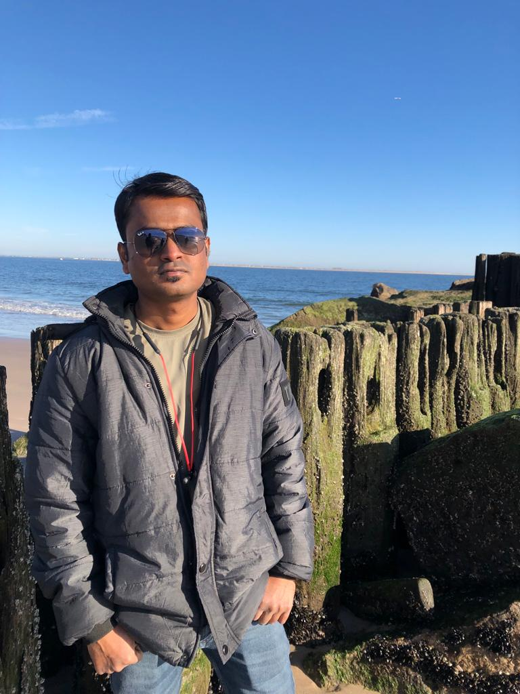
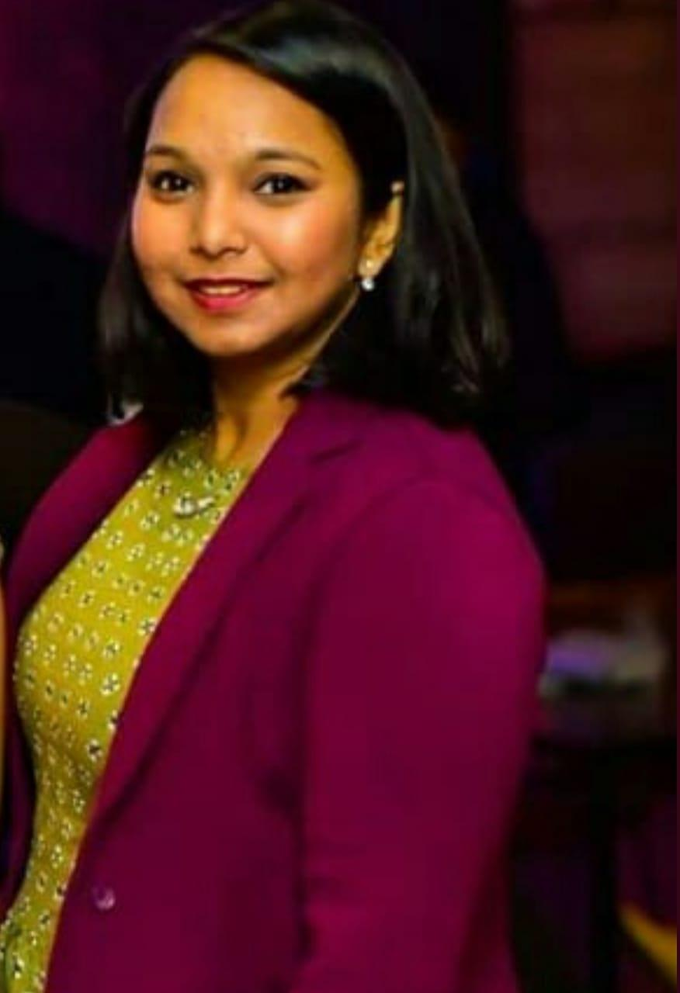
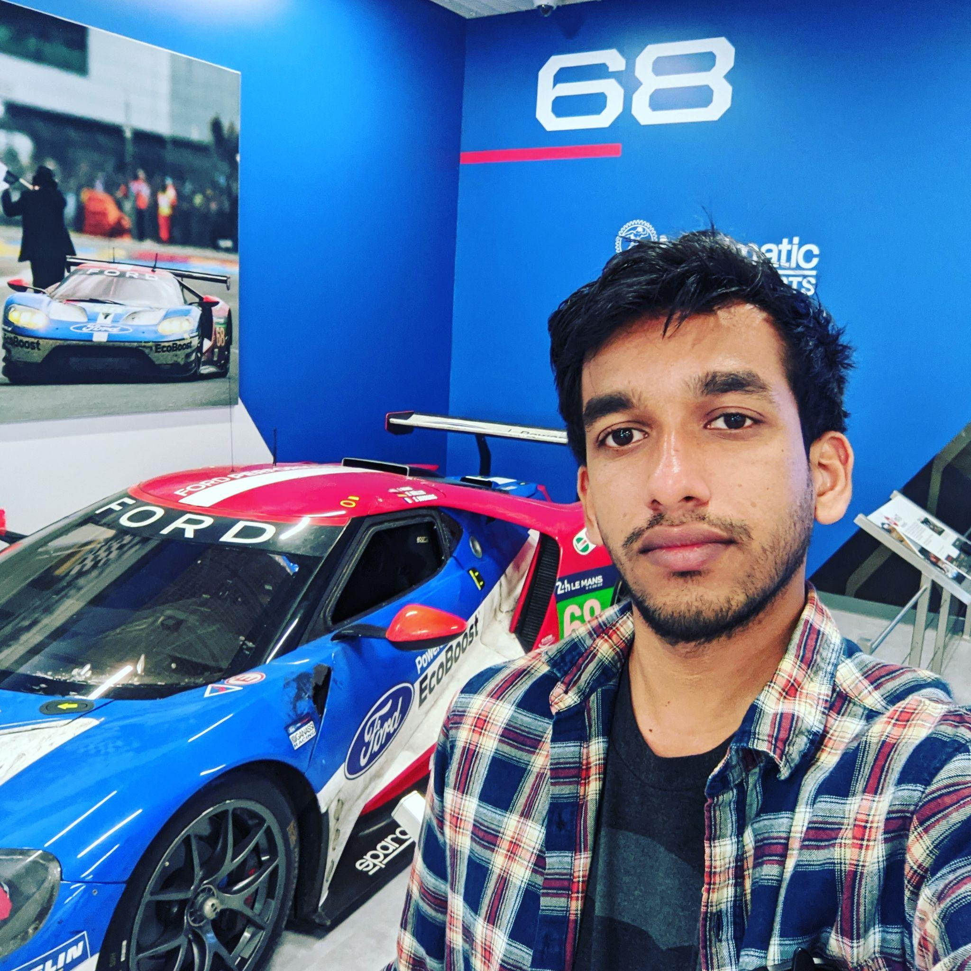
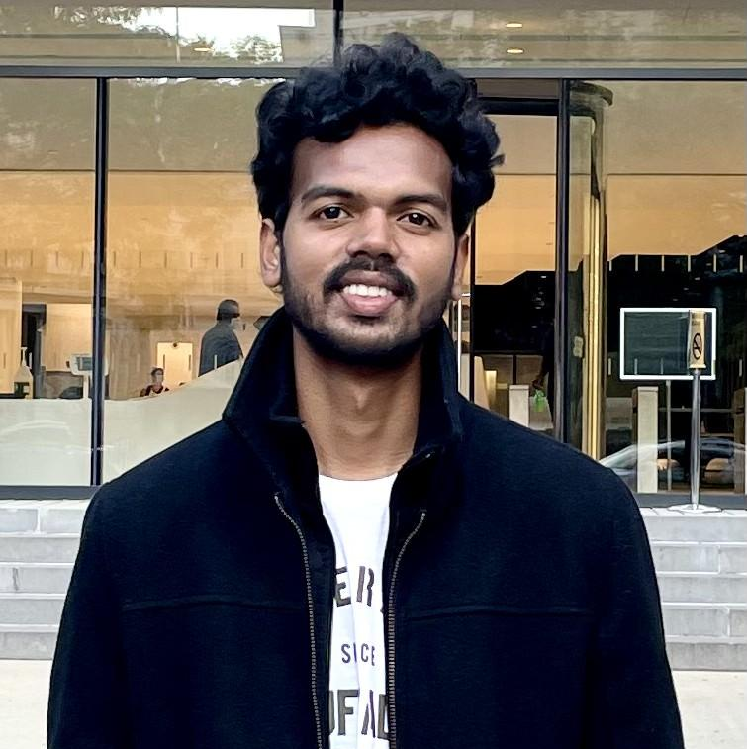
Nicholas Wong: Machine Learning Engineer
1. Design Computer Vision Model Architecture
2. Train and Evaluate Model Performance
3. Gather representative image data for training
Rajat Nagavkar: Ios Developer
1. Design and Development of Application.
2. Integrating ML model to provide specified results.
3. Testing the app to provide a better user experience.
TEAM MEMBER ROLES
Aakansha Agarwala: Project Manager/Scrum Master
1. Led team meetings and kept the team on task
2. Maintains the project’s GitHub repository and Wiki
3. Documented test cases and co-authored technical paper
Austin Blaise: Cloud Engineer
1. Contribute to the architecture of the project
2. Creates Infrastructure as code
3. Integrated features and services
Suryadeep Nallana: FullStack Developer/Quality Analyst
1. Contribution to design and development of the app layout
2. Authored technical document of the project
3. Working towards making our app user-friendly

Slide 4

PROJECT OVERVIEW

Slide 5

PROBLEM STATEMENT
As the population is increasing the amount of waste produced is also increasing.
The world produces 2.01 billion tons of urban solid waste yearly, with the United States being the highest producer of waste.
Most of the waste produced remains unprocessed due to a lack of recycling knowledge.
Squander app overcomes this problem by providing a way for waste recycling through a machine learning platform.

Slide 6
PROJECT DESCRIPTION
Squander app provides a complete solution to organize and plan the disposal of waste. It uses a machine learning algorithm to detect recyclable waste from images and provide proper disposal.
What?
Image-based Waste detection mobile application
How?
User image submission
Trained machine learning-based model
Results and information
Why?
Image-based
Easy tool to detect waste
Simple steps to undergo
Nearest recycling location provided along with the rates and the options to schedule a pick

Slide 7

PERSONA

Slide 8

Jill, the party host
Background Profile:
Jill, a 32-year-old. He is an organizer of a well-reputed company in the city. He has organized many big parties and is always busy with his job. He takes all the responsibility and his duties also include providing a good food service. He bets many clients, particularly for the food he provides. His organization is popular among the people Jill does many parties and he collected more food waste by the end of the party. Jill would like to know the waste identified from the image uploaded so that he can confirm the photo he uploaded was processable.
How can Squander help?
Jill being responsible for organizing the party. He wants to recycle all the waste by segregating in rightful manner and help the surrounding environment. He can use an application. Squander which provides his needs by showing the results of nearest recycling company location for all the food waste from his parties that happen wherever in the city. Squander makes an efficient and easiest way in someone’s life like Jill’s

Slide 9
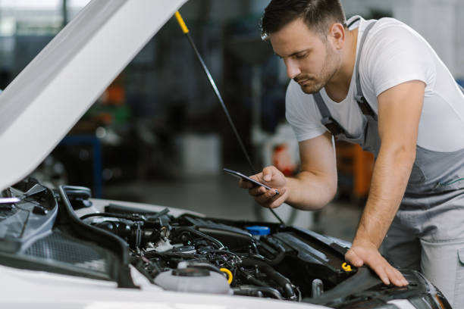
Simon, the mechanic
Background Profile:
Simon is a mechanic for ten years. His age is of 35 years. His jobs is to inspect and repair vehicles, machinery, and light trucks. And he is known for his good service providing for his customers. He works in an indoor garage. Simon’s culminated with metallic waste from his work and he wants to find a recycling location to recycle it and make some money from scrap
How can Squander help?
Simon can use the Squander application that helps him to find the nearest recycling company location for the waste to recycle from the comfort of his garage. This would allow him to find and provide easy access directly to the recycling company. He doesn’t have to worry about the waste and where to recycle it. Through Squander it makes his life easier.

Slide 10
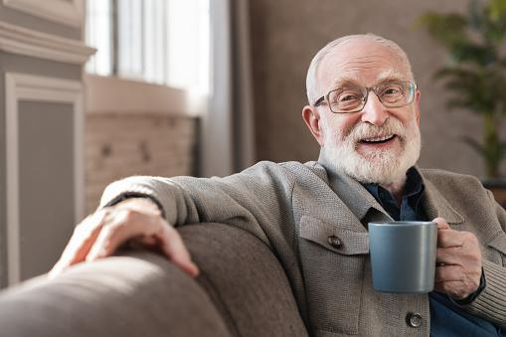
David, the retiree
Background Profile:
David was a sale executive in a marketing firm. He retired from the job recently. He was successful and has been an inspiration for others in the company. After his retirement, David brought up the interest he had for quite some time to renovate his house. He wants to give a personal touch to the house and lead the rest of his life happily in his way. Now he is spending all his time taking care of the process under his supervision and making a beautiful house for himself
How can Squander help?
Squander can be helpful for David, as he is looking after the construction works for his house. The waste can generate a lot, with all the accumulated waste, he can recognize the waste under categories within the app and send it to his nearest garbage station. That’s make David being responsible for his waste and keeping the environment at a better position.

Slide 11

MINIMAL VIABLE PRODUCT

Slide 12




Recognition Model for Image Recognition of waste items
Model responds with confidence values on labels of recognized waste items
Results based on the waste items categorized with how many no of recyclable items found
Quick and easy method for finding the nearest recycling companies location
Steps:
Uploading Image Find Nearby Location Processing Image Image Results
Minimal Viable Product (MVP)

Slide 13
PROJECT REQUIREMENTS
Upload Image
Detect Waste
Classify Waste
Receive Results

Slide 14







TECHNOLOGIES USED
AWS Cloudformation

Slide 15

ARCHITECTURE DESIGN

Slide 16
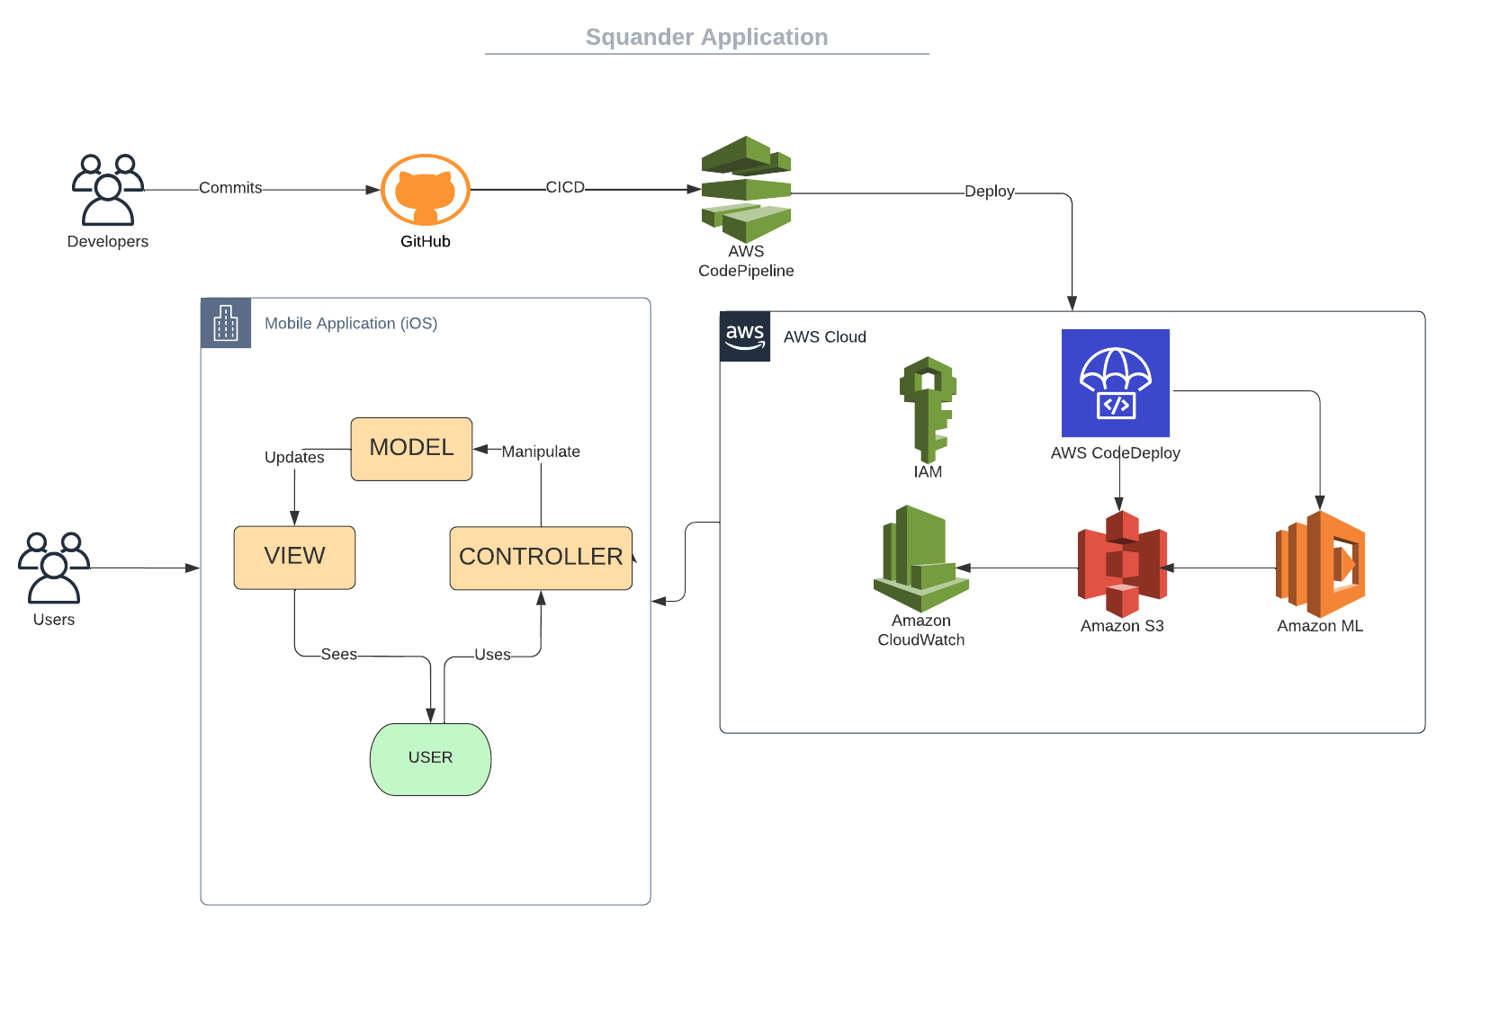
SQUANDER ARCHITECTURE

Slide 17
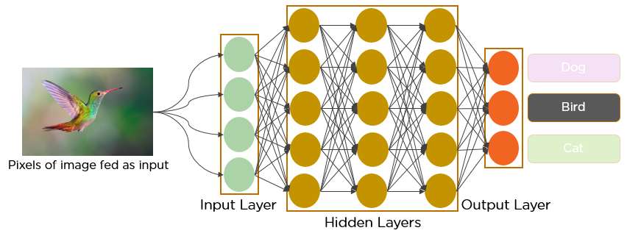
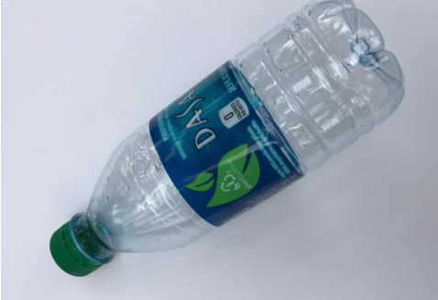
MACHINE LEARNING ALGORITHM
Plastic
Cardboard
Trash

Slide 18
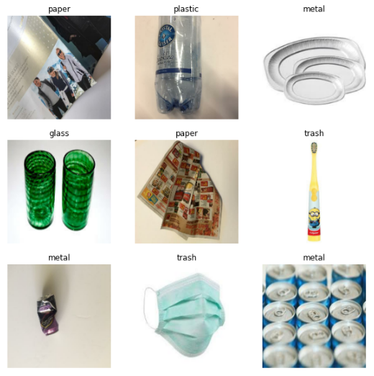
Model: Classification
Model is able to classify trash into the following categories:
Cardboard
Glass
Metal
Paper
Plastic
Miscellaneous Trash

Slide 19
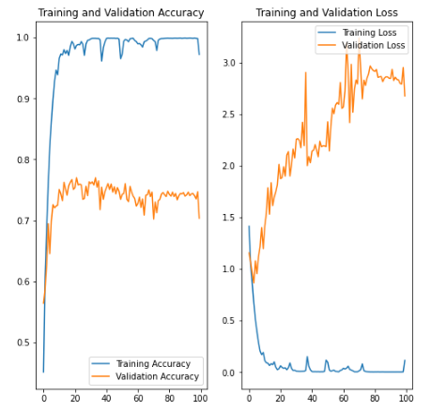
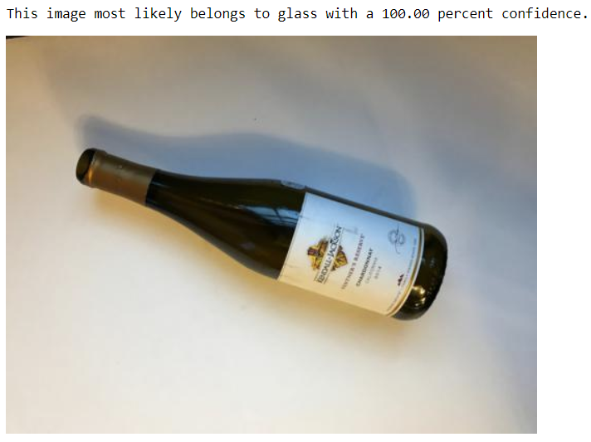
MODEL EVALUATION

Slide 20

SPRINT OVERVIEW

Slide 21
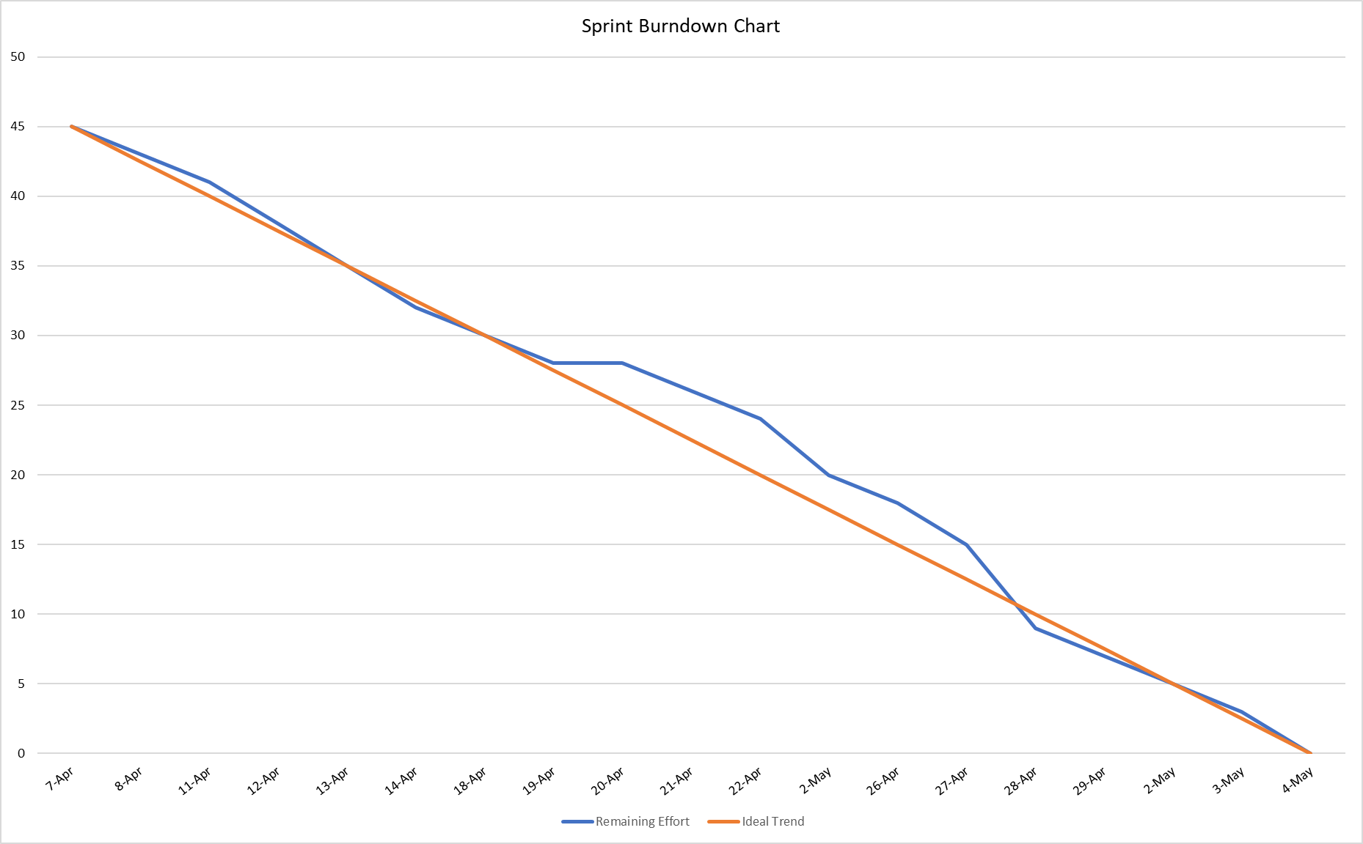
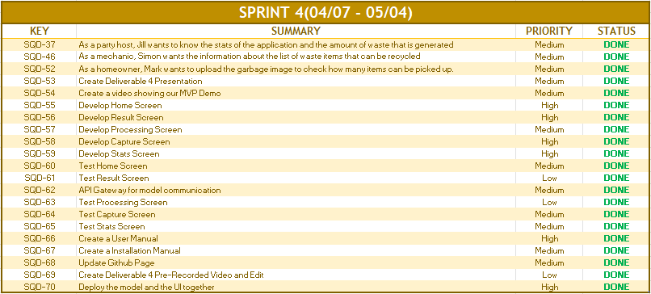
REVIEW SPRINT IV

Slide 22
SPRINT IV vs SPRINT V
SPRINT IV | SPRINT V
Finished the first iteration of our application UI design | Determined and mapped out goals for future deliverables.
Deployed our model solution into our application architecture | Navigation Bar feature is added in our application
Recognize a larger range of trash in model | Model confidence value improved
 | Researched necessary technologies to achieve our goals

Slide 23
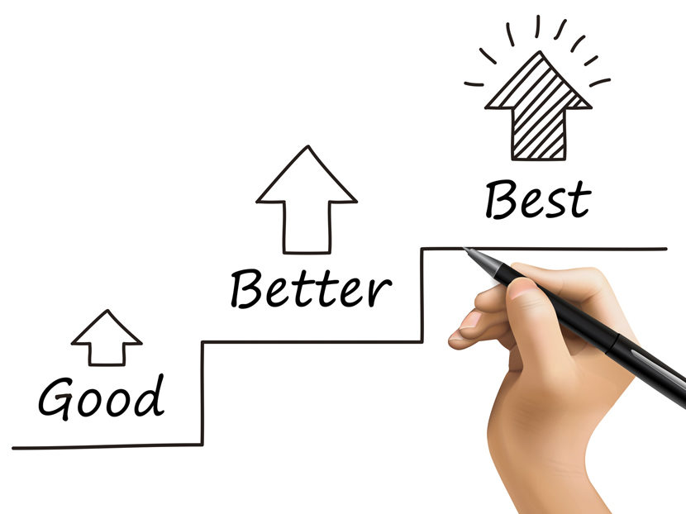
IMPROVEMENT
We want to improve both technically and with our presentation
Technical
Improve our interface and add additional content for users
Improve our model with multiple entity recognition and more accuracy
Improve maintainability of the project
Presentation
Try to be more concise in our verbal presenting.
More Energy

Slide 24

BACKLOG

Slide 25
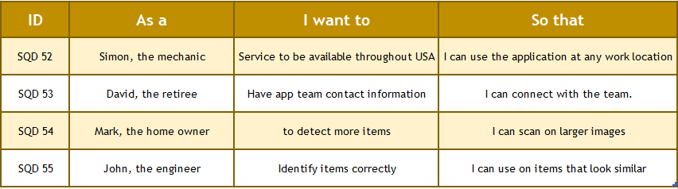
USER STORIES & ACCEPTANCE CRITERIA
SQD 52, and SQD 53 user stories are completed in Sprint 5, and SQD 54, and SQD 55 are planned in Sprint 6

Slide 26
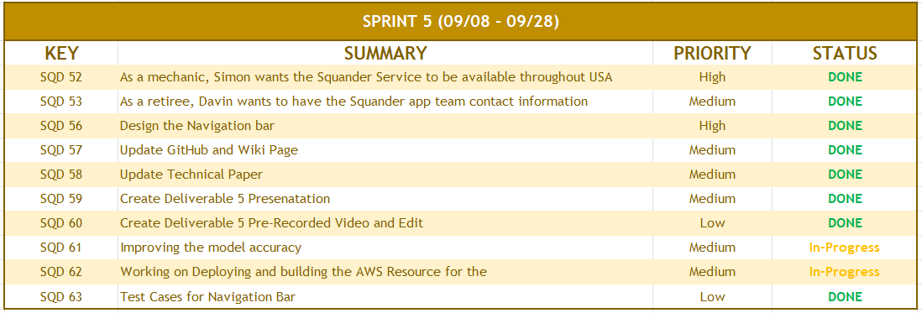
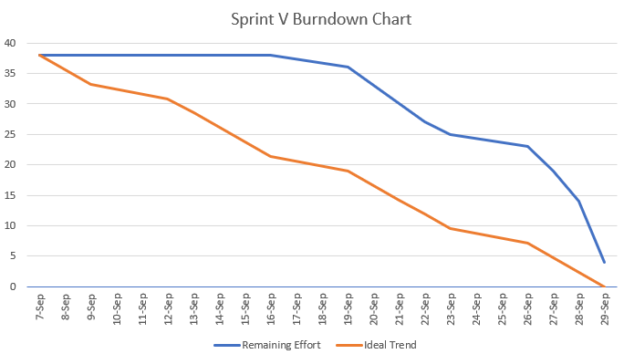
REVIEW SPRINT V
SQD 61 and SQD 62 are spilled into Sprint 6 as there is continuous improvement and building upon the resource

Slide 27
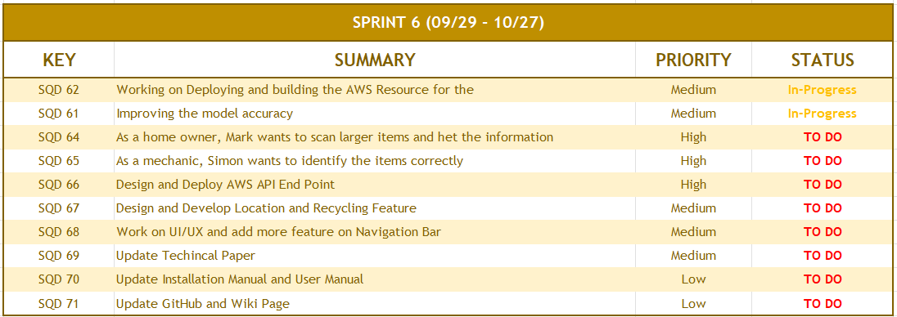
FUTURE SPRINT(SPRINT VI)

Slide 28
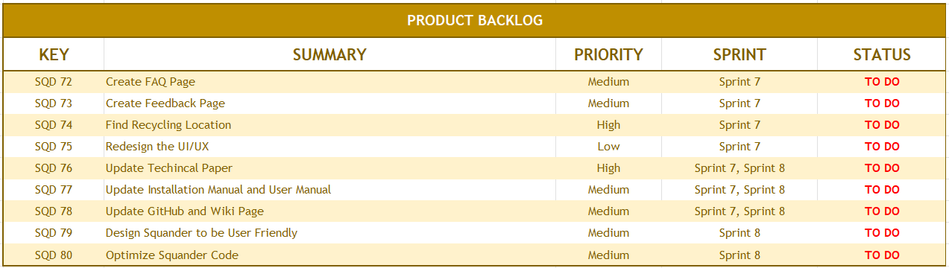
PRODUCT BACKLOG
No task has been removed; we have only added new tasks like
SQD 80, SQD 75, SQD 79

Slide 29

TEST CASES

Slide 30
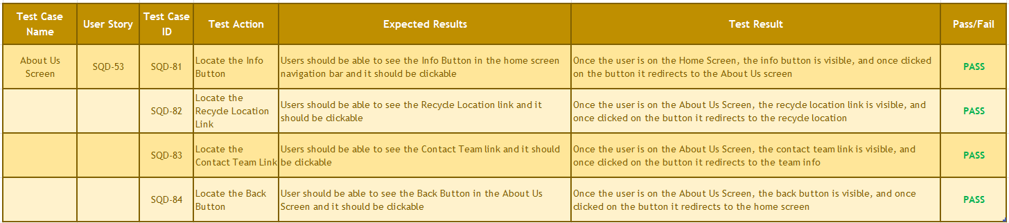
TEST CASES

Slide 31
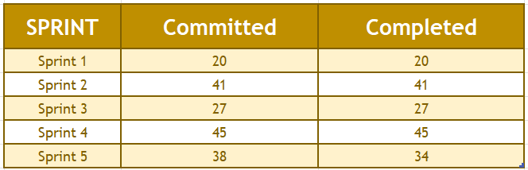
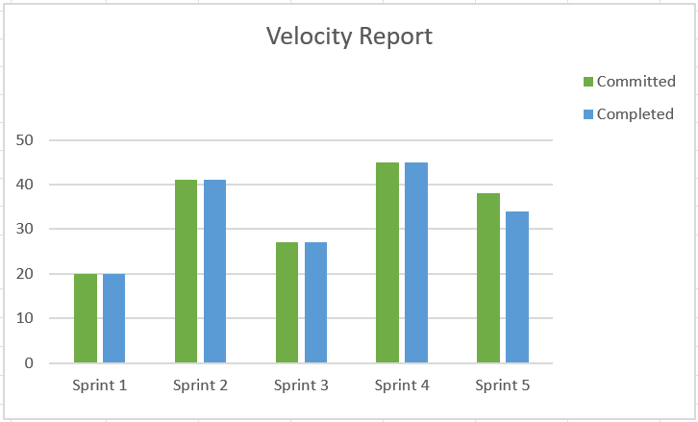
VELOCITY CHART

Slide 32
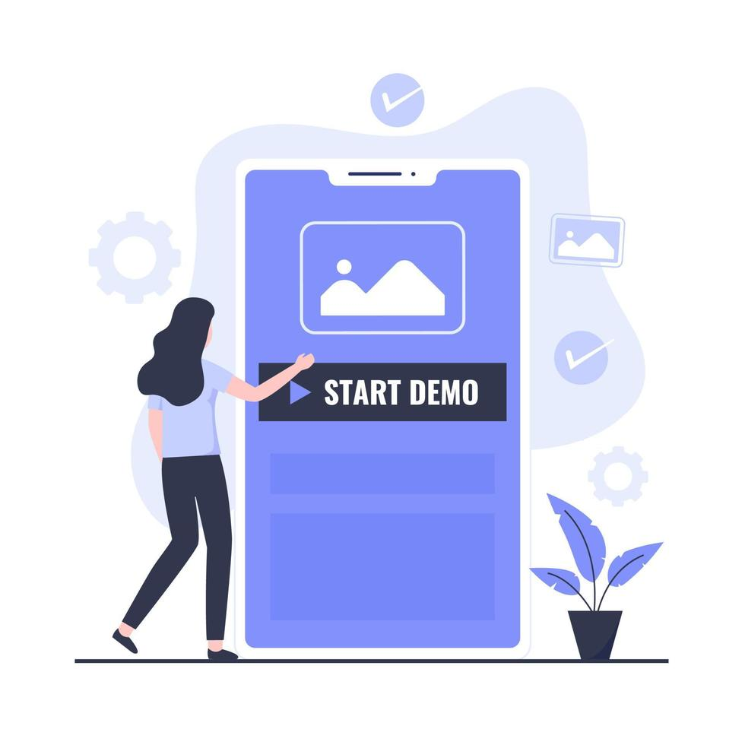
PROJECT DEMO
GitHub Link: - https://github.com/anku518/Squander/wiki

Slide 33
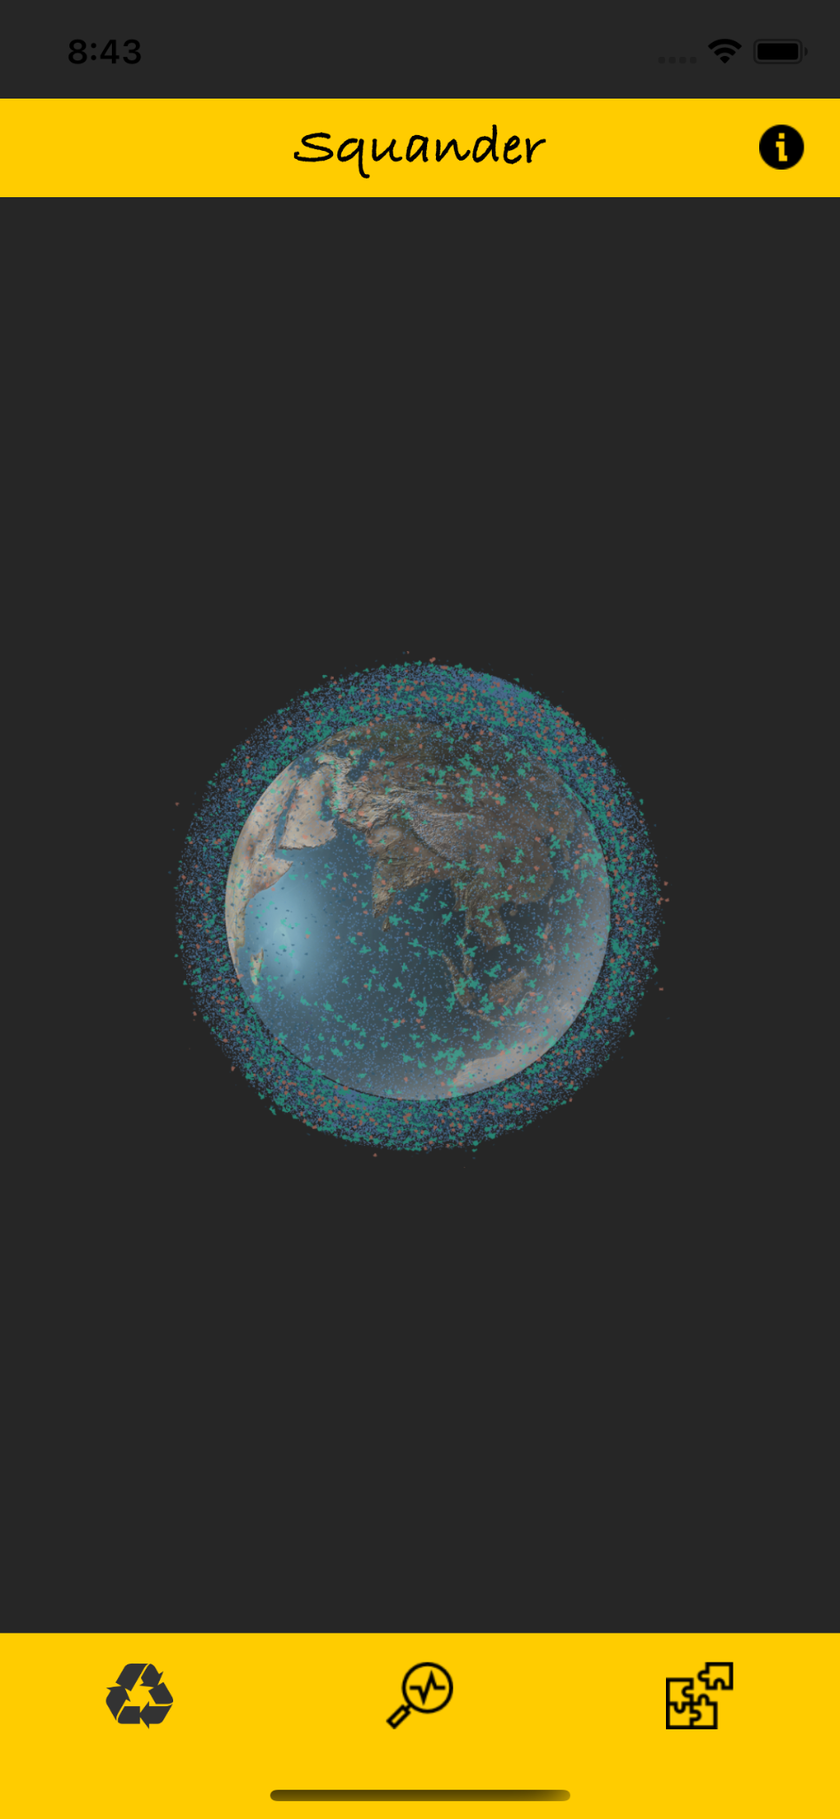
App Screenshots
Home Screen Info button added at navigation bar

Slide 34
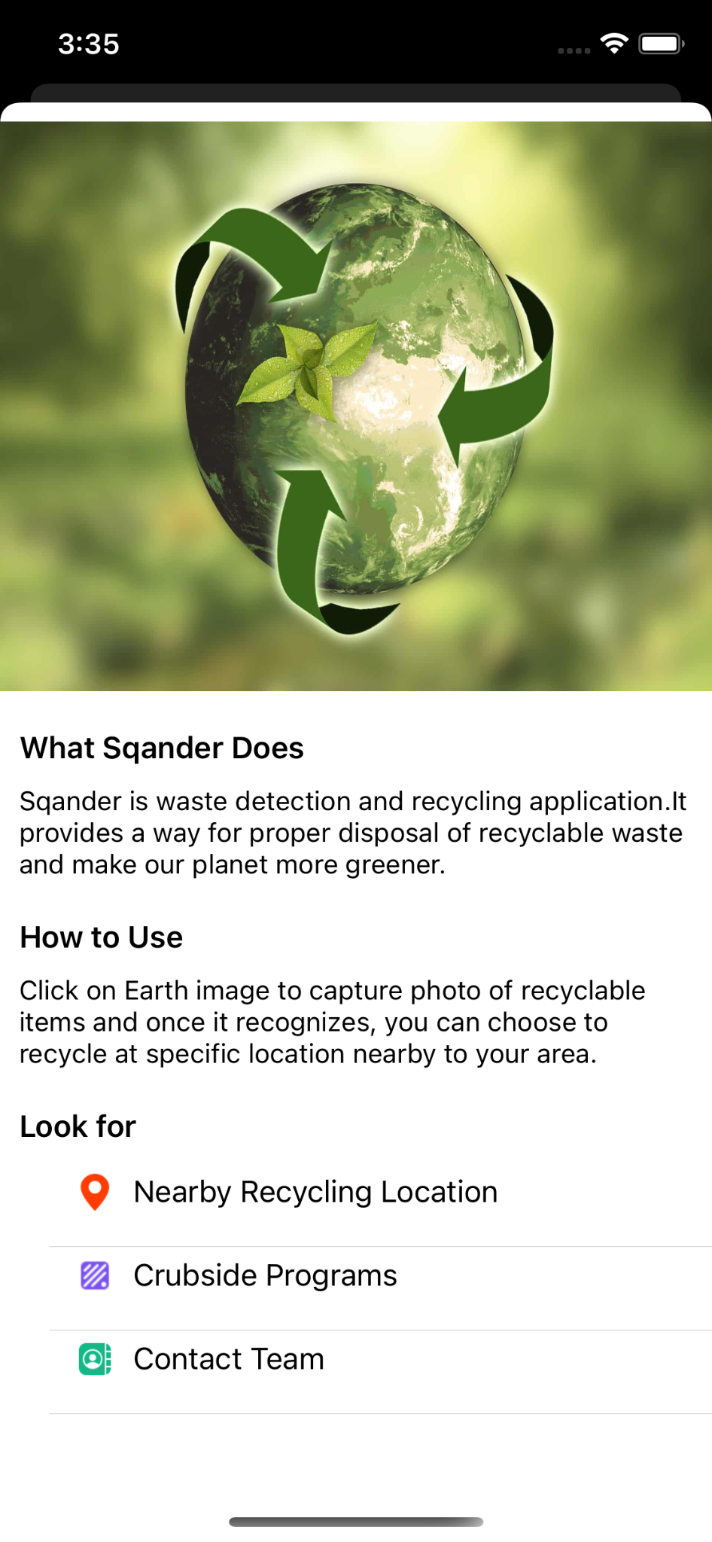
Continue…
About Screen showing info about the app and recycling guide

Slide 35
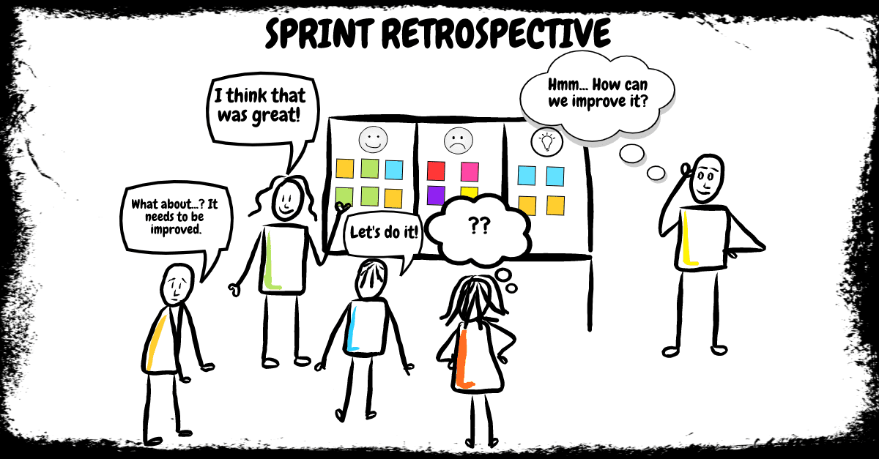
RETROSPECTIVE

Slide 36
RETROSPECTIVE
01
What went well
Deliverable deadlines
Talk distribution and scrum master resolving blockers
02
What needs improvement
Code Maintainability
Story commitment with velocity
03
Future Actions
Reduce technical debt
Better estimation of deadline

Slide 37

CONCLUSION

Slide 38
CONCLUSION
Application Recap:
Squander facilitates the waste materials of users.
Currently can specify cardboard, glass, metal, paper, plastic and miscellaneous trash.
Provides information about app, its use and
Recycling links.
Provides:
Model results
Information on the wastage
Location of the nearest recycling factory
Future Scope:
Improve model accuracy to detect more waste
By increasing quantity of training data.
Implement inheritance learning, object
segmentation and multiple object recognition.
Showing recycling locations nearest to user location.
Add more features to the application such as scheduling and environmental impact tracing.
Keeping track of users contribution towards
waste recycling.

